Slide 1
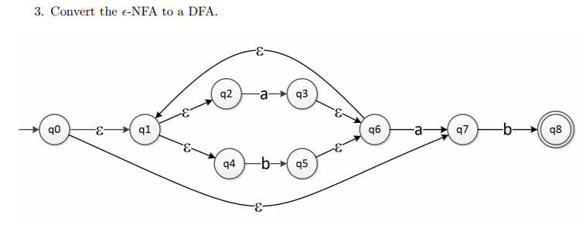

Slide 5
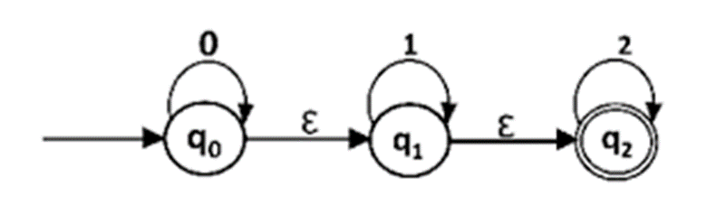

Slide 6
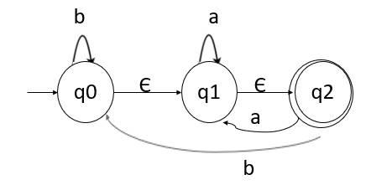
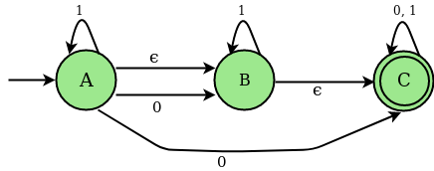
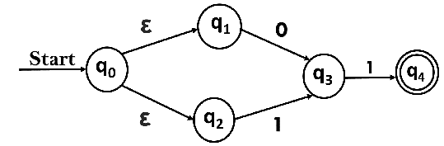
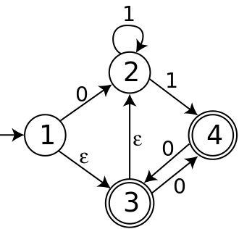

Slide 7
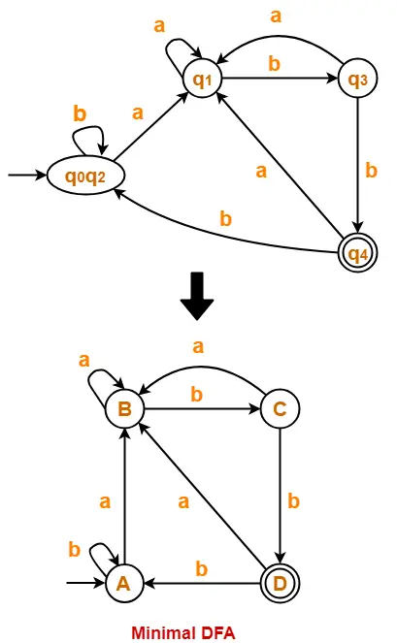

Slide 8
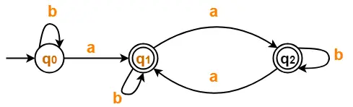
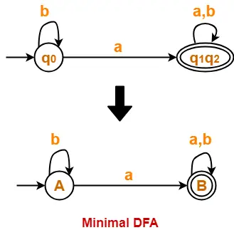

Slide 9
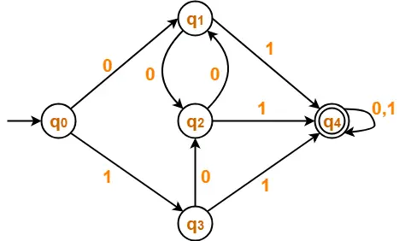
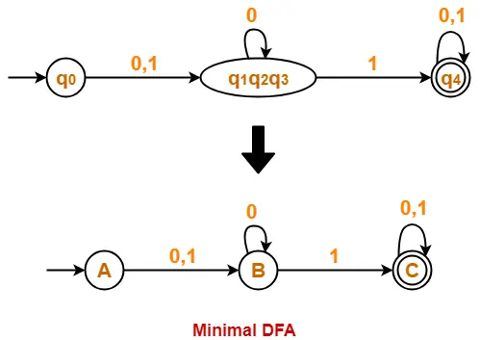

Slide 10
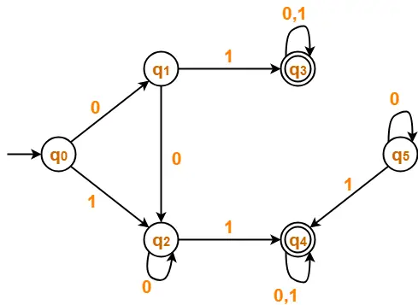
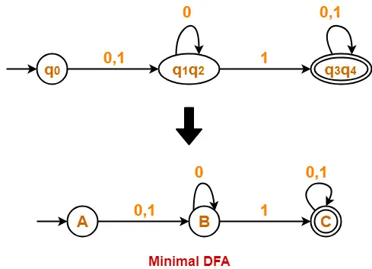

Slide 11
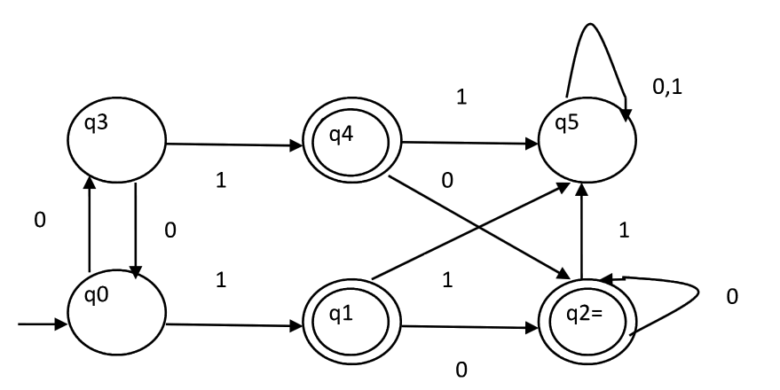

Slide 12
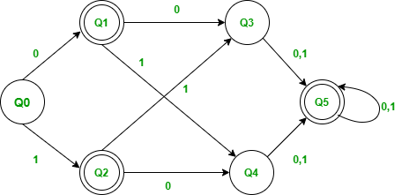
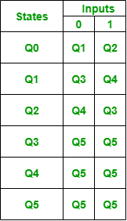

Slide 13
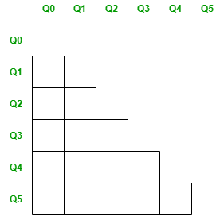
Minimizing the above DFA :
Step-1: Create the pairs of all the states involved in DFA.

Slide 14
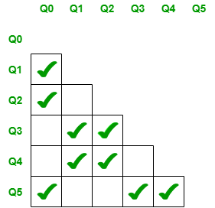
Step-2: Mark all the pairs (Qa,Qb) such a that Qa is Final state and Qb is Non-Final State.

Slide 15
Step-3: If there is any unmarked pair (Qa,Qb) such a that δ(Qa,x) and δ(Qb,x) is marked, then mark (Qa,Qb). Here x is a input symbol. Repeat this step until no more marking can be made.
Check for the unmarked pair Q2,Q1
Check when x=0 : δ(Q2,0) = Q4 and δ(Q1,0) = Q3, check if the pair Q4,Q3 is marked and no it is not marked.
Check when x=1 : δ(Q2,1) = Q3 and δ(Q1,1) = Q4, check if the pair Q4,Q3 is marked and no it is not marked.
Hence we cannot mark the pair Q2,Q1.
Check for the unmarked pair Q3,Q0
Check when x=0 : δ(Q3,0) = Q5 and δ(Q0,0) = Q1, check if the pair Q5,Q1 is marked and no it is not marked.
Check when x=1 : δ(Q3,1) = Q5 and δ(Q0,1) = Q2, check if the pair Q5,Q2 is marked and no it is not marked.
Hence we cannot mark the pair Q3,Q0.
Check for the unmarked pair Q4,Q0
Check when x=0 : δ(Q4,0) = Q5 and δ(Q0,0) = Q1, check if the pair Q5,Q1 is marked and no it is not marked.
Check when x=1 : δ(Q4,1) = Q5 and δ(Q0,1) = Q2, check if the pair Q5,Q2 is marked and no it is not marked.
Hence we cannot mark the pair Q4,Q0.

Slide 16
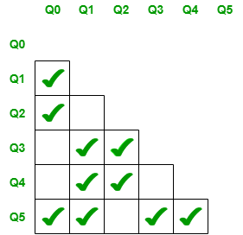
Check for the unmarked pair Q4,Q3
Check when x=0 : δ(Q4,0) = Q5 and δ(Q3,0) = Q5, Such pair of state Q5,Q5 don’t exists.
Check when x=1 : δ(Q4,1) = Q5 and δ(Q3,1) = Q5, Such pair of state Q5,Q5 don’t exists.
Hence we cannot mark the pair Q4,Q3.
Check for the unmarked pair Q5,Q1
Check when x=0 : δ(Q5,0) = Q5 and δ(Q1,0) = Q3, check if the pair Q5,Q3 is marked and yes it is marked.
Hence we can mark the pair Q5,Q1.
Check for the unmarked pair Q5,Q2
Check when x=0 : δ(Q5,0) = Q5 and δ(Q2,0) = Q4, check if the pair Q5,Q4 is marked and yes it is marked.
Hence we can mark the pair Q5,Q2

Slide 17
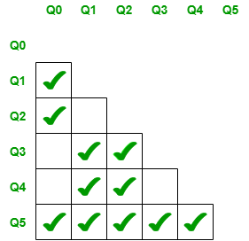
We have checked for all the unmarked pairs but don’t need to stop here we need to continue this process until no more markings can be made.
Check for the unmarked pair Q2,Q1
Check when x=0 : δ(Q2,0) = Q4 and δ(Q1,0) = Q3, check if the pair Q4,Q3 is marked and no it is not marked.
Check when x=1 : δ(Q2,1) = Q3 and δ(Q1,1) = Q4, check if the pair Q4,Q3 is marked and no it is not marked.
Hence we cannot mark the pair Q2,Q1.
Check for the unmarked pair Q3,Q0
Check when x=0 : δ(Q3,0) = Q5 and δ(Q0,0) = Q1, check if the pair Q5,Q1 is marked and yes it is marked.
Hence we can mark the pair Q3,Q0.

Slide 18
